Slide 1
Multiple Choice vs. Performance Based Tests in High School Physics Classes
Katie Wojtas

Slide 2
Introduction
Majority tests multiple-choice (MC)
Effective?
May not adequately assess student understanding
Investigate efficacy of MC versus performance-based (PB) tests

Slide 3
What is a Multiple Choice Test?
Test with questions having many answers from which one is chosen
Each question made up of 2 parts
Stem: question
Options: also made up of 2 parts
The answer
Distracters- incorrect but tempting options

Slide 4
What is a Performance Based Test
Test measuring students' academic achievement by evaluating performance on hands-on tasks
Two types in Physics Class:
Word Problems
Lab Test

Slide 5
Multiple Choice Tests
Advantages
Disadvantages
Test a wide range of topics
Little to no grading bias
Only one true answer
Easily administered to large groups of people
Don’t allow students to express their thoughts
Memorize facts without understanding
May overestimate student’s learning
Students are able to use elimination process

Slide 6
Performance Based Tests
Advantages
Disadvantages
Assess students from multiple perspectives
Allow creativity and expression of thoughts
Help teachers understand student’s learning and thought process
Time consuming to administer
Time consuming to grade
Poor design, may not accurately assess student’s knowledge

Slide 7
Method
Find testing environment
Write tests
Administer
Grade
Analyze results

Slide 8
Writing a MC Test
Read material
Key content

Slide 9
Writing a MC Test Content on MC Test
1-D Kinematics
Objects in free fall
Acceleration due to gravity
Constant velocity
Constant acceleration - not due to gravity
Average velocity
Average acceleration

Slide 10
Writing a MC Test
Read material
Key points
Consulted existing test banks
Selected questions
Revised test
Professionally reviewed

Slide 11
Content on PB Test
Kinematics in 1-D
Focused on constant velocity
Lab - Velocity of a Motorized Cart

Slide 12
Expected results
Those who knew the material
High grades on both tests
Those who kind of knew the material
Higher grade on multiple choice, lower grade on performance based
Those who didn’t know the material
Low grade on both tests

Slide 13
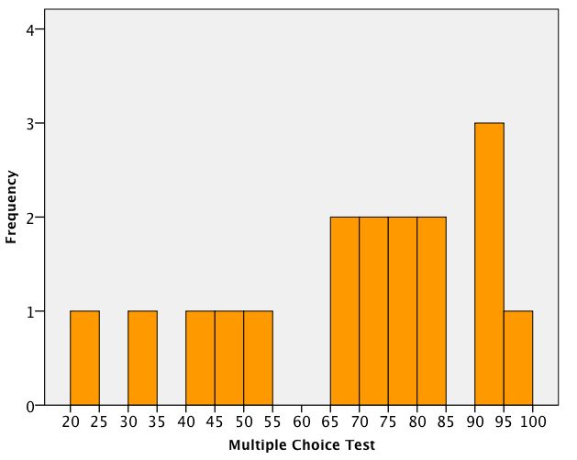
Teacher 1 MC

Slide 14
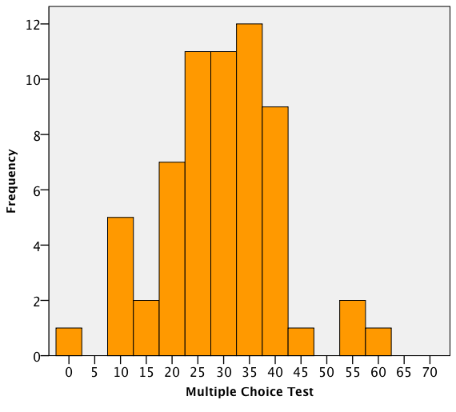
Teacher 2 MC

Slide 15
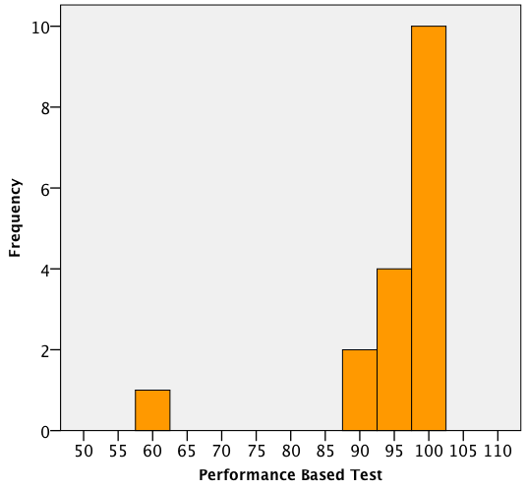
Teacher 1 PB

Slide 16
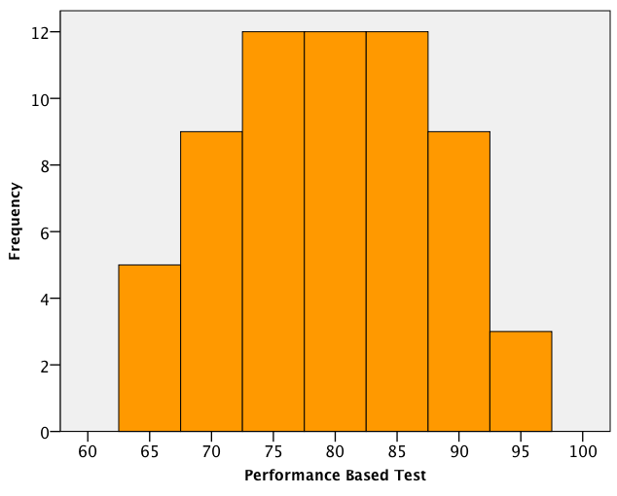
Teacher 2 PB

Slide 17
Data
Teacher 1:
MC Mean - 68.53
PB Mean - 95.29
Teacher 2:
MC Mean - 29.13
PB Mean - 79.52

Slide 18
Results
Teacher 1- much higher grades than Teacher 2
Why?
Incentive
Teacher 1 - incentive
Teacher 2 - no incentive
Level of math

Slide 19
Results
Overall better on PB than MC
Why?
Easier test
Knew information better

Slide 20
Motivation
Different between teacher 1 and 2
External motivation did not effect PB test scores
Both classes performed better on PB regardless of motivation

Slide 21
Results

Slide 22
Possible Sources of Error
Tests did not fully cover the same material
MC test covered more material
Bias in grading
Incorrect grading
Deliberate false data

Slide 23
Future Work
Control all possible variables
Increase number of test subjects
Get background information
Replace PB lab with word problem test
3rd party grading of all tests
Provide incentive

Slide 24
Conclusion
Due to sources of error, results were inconclusive
PB tests yield higher results regardless of incentive
Do we want students to get good grades or learn the material?

